Slide 1
UDP2HIBI usage+implementation
Jussi Nieminen
Last update 11.1.2010

Slide 2
Purpose
Connect FPGA board to PC
Use cross-connected ethernet cable
Structure
Controller for Ethernet PHY chip
Block for handling UDP headers
Adapter to interface with HIBI (main focus of this document)

Slide 3
Use case example
Transferring data between a PC and an SDRAM
Nios controls the events but the transfer itself happens between the SDRAM and the PC
In the name of simplicity, some less relevant blocks have been left out from the following diagrams
Ethernet
controller
NIOS II
UDP/IP
NIOS2HIBI
UDP2HIBI
HIBI
HIBI SDRAM
controller
SDRAM

Slide 4
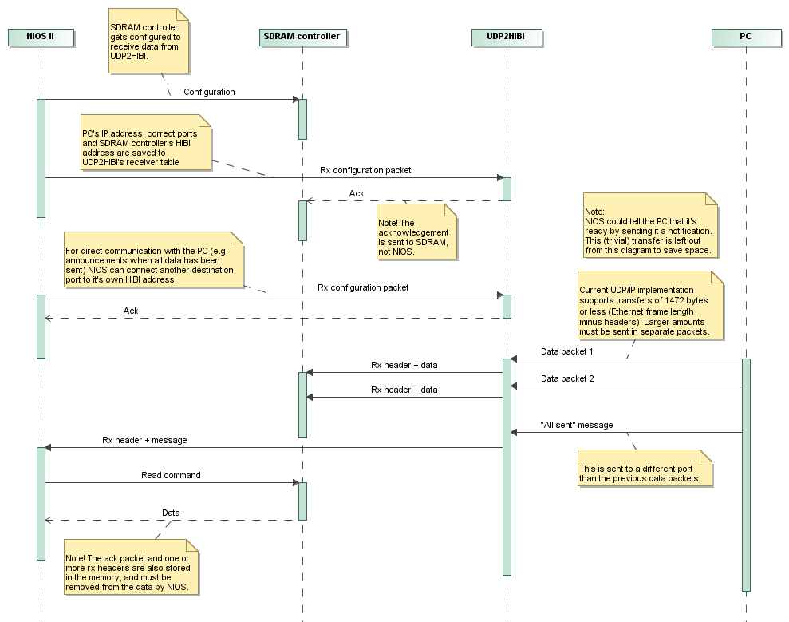
Data from PC to SDRAM

Slide 5
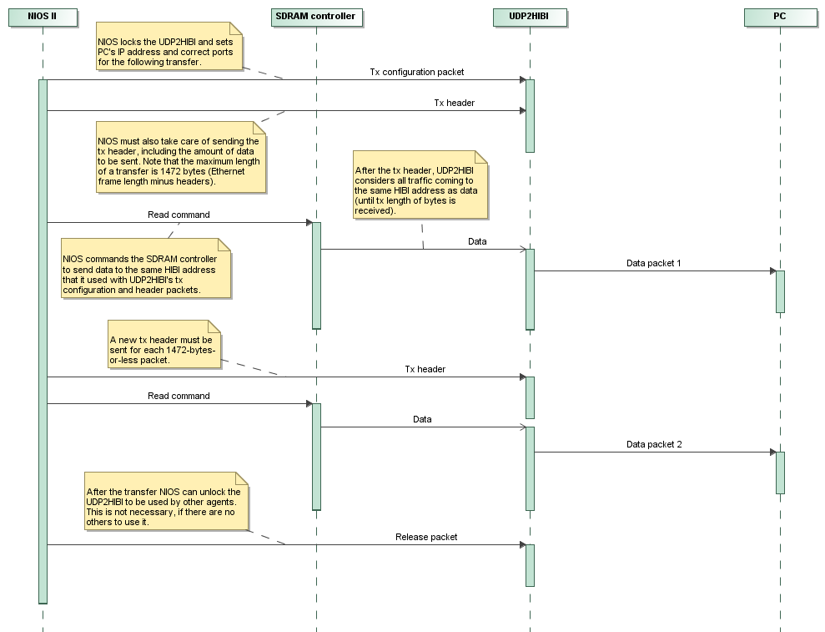
Data from SDRAM to PC

Slide 6
HIBI UDP Basics
Interface between a UDP/IP block and the HIBI bus
Capable of handling one transmission and one incoming packet at a time
UDP2HIBI uses HIBI addresses to separate transfers from different agents
So all agents must use different addresses when sending to UDP2HIBI

Slide 7
Tx side
Before a transfer can begin, the UDP2HIBI must be configured by sending a configuration packet
Sets destination IP address and UDP ports
Locks the UDP2HIBI to the used hibi address so that no one else can interfere with the transfer.
The transfer is started with a specific tx header
Sets the tx length
After the header, all words sent by that agent are considered as data until tx length of bytes has been received
After the transmission the UDP2HIBI must be released with a release packet so that others can use it

Slide 8
Sequence diagram
CPU 2
CPU 1
UDP2HIBI
Tx configuration
To addr: 0x01234567
UDP2HIBI locked to address 0x01234567
Ack
Tx configuration
To addr: 0x01234568
UDP2HIBI refuses other communication attempts while locked
Nack
Tx data
To addr: 0x01234567
The first data transfer must contain a Tx header with tx length
Tx data
To addr: 0x01234567
Tx data
To addr: 0x01234567
Tx configuration
To addr: 0x01234568
UDP2HIBI refuses again
Nack
Tx data
To addr: 0x01234567
Tx data
To addr: 0x01234567
Last data received
Tx release
To addr: 0x01234567
UDP2HIBI no longer locked to address 0x01234567
Tx configuration
To addr: 0x01234568
UDP2HIBI locked to address 0x01234568
Ack
Tx data
To addr: 0x01234568
And so on...

Slide 9
Rx side
Agents can connect UDP/IP addresses (IP address, UDP ports) to their own hibi addresses by sending UDP2HIBI an rx configuration packet
The information is stored to a receiver table so that different agents can connect different IPs/ports to their own addresses
Wildcard values (all ones, e.g. Port 0xFFFF) can also be used
An ack packet is sent if there was room in the table, nack otherwise
Future work includes adding a possibility to remove a table entry
If the IP address/ports of a received transmission match with a table entry, the packet gets forwarded to the corresponding hibi address
Otherwise the transmission is simply discarded

Slide 10
Used packet types
Following slides introduce the packets and headers used with UDP2HIBI
The ones from 1 to 4 are sent by agents to UDP2HIBI, and 5 to 7 vice versa
These are defined in udp2hibi_pkg.vhd
Uppermost 4 bits in the first word define the type
0x0-0x2: Tx conf, tx data, tx release
0x3-0x4: Rx conf, rx data
0x5-0x6: Ack, nack

Slide 11
Used packet types (1/7)
Tx configuration
Feeds UDP2HIBI with Tx parameters
Destination IP address
Destination UDP port
Source UDP port
Timeout value
Sender’s HIBI address is there to enable sending of an ack/nack
Locks UDP2HIBI to the HIBI address that this packet is sent to (not to the sender’s address)
Packets sent to other UDP2HIBI’s HIBI addresses will be replied with a nack
31...28,27...........................................................0
4 bits:
0x0
28 bits:
Timeout value
31.......................................................................0
32 bits:
Destination IP address
31..............................16,15................................0
16 bits:
Dest. UDP port
16 bits:
Source UDP port
31.......................................................................0
32 bits:
Sender’s HIBI address

Slide 12
Used packet types (2/7)
Tx data
0x1 indicates start of a Tx
Tx length is given in it’s own field
After the Tx data header all received words from the same sender (sent to the same HIBI address) are treated as data
Tx is considered complete when tx length of words has been received or timeout stops the activity
31....28,27..............17,16....................................0
4 bits:
0x1
11 bits:
Tx length (n)
17 bits:
Don’t care
31...........24,23...........16,15............8,7...............0
8 bits:
Data 3
8 bits:
Data 2
8 bits:
Data 1
8 bits:
Data 0
...
31...........24,23...........16,15............8,7...............0
8 bits:
Don’t care
8 bits:
Don’t care
8 bits:
Data n-1
8 bits:
Data n-2

Slide 13
Used packet types (3/7)
Tx release
Releases UDP2HIBI’s address lock to make the block usable for others again
No ack/nack will be sent
31...28,27...........................................................0
4 bits:
0x2
28 bits:
Don’t care

Slide 14
Used packet types (4/7)
Rx configuration
Connects a HIBI address with a certain source IP address and UDP source/destination ports
Any incoming transfer that matches the address and ports will be sent to given HIBI address
An ack/nack will be sent to the given HIBI address to announce success of the operation
31...28,27...........................................................0
4 bits:
0x3
28 bits:
Don’t care
31.......................................................................0
32 bits:
Source IP address
31.............................16,15.................................0
16 bits:
Dest. UDP port
16 bits:
Source UDP port
31.......................................................................0
32 bits:
Destination HIBI address

Slide 15
Used packet types (5/7)
Rx data
Header type 0x4 indicates start of an icoming transmission
Rx length in it’s own field
After the header, data words follow until all has been sent (Rx length of bytes)
31....28,27...............17,16...................................0
4 bits:
0x4
11 bits:
Rx length (n)
17 bits:
Don’t care
31...........24,23...........16,15............8,7...............0
8 bits:
Data 3
8 bits:
Data 2
8 bits:
Data 1
8 bits:
Data 0
...
31...........24,23...........16,15............8,7...............0
8 bits:
Don’t care
8 bits:
Don’t care
8 bits:
Data n-1
8 bits:
Data n-2

Slide 16
Used packet types (6/7)
Ack
Acknowledges a received configuration packet
After Tx configuration packet:
bit 27 = ’1’
Means that the UDP2HIBI has been locked to the used HIBI address and is ready to transfer
After Rx configuration packet:
bit 27 = ’0’
Given parameters have successfully been saved to the rx address table
In hexadecimal: 0x58… or 0x50… assuming all zeros for don’t care bits
31....28, 27 ,26................................................0
4 bits:
0x5
1 bit:
Tx/Rx
28 bits:
Don’t care

Slide 17
Used packet types (7/7)
Nack =negative ack
Configuration packet not received
After Tx configuration packet:
bit 27 = ’1’
Means that the UDP2HIBI has been locked to some other HIBI address and is not available right now
After Rx configuration packet:
bit 27 = ’0’
No room for new entries in the Rx address table
In hexadecimal: 0x68… or 0x60… assuming all zeros for don’t care bits
31....28, 27 ,26................................................0
4 bits:
0x6
1 bit:
Tx/Rx
28 bits:
Don’t care

Slide 18
Future work
Possibility to delete a receiver table entry
Possibility to reset the block via HIBI
Maybe a table for transfer information too
Only one configuration packet needed per agent
Tx data header would result in an ack/nack according to UDP2HIBI state
No release packets
UDP2HIBI would release the lock automatically after transferring tx length of data
Testing and user experiences needed to see if this is worth doing

Slide 19
UDP2HIBI implementation
Jussi Nieminen
Last update 18.1.2010

Slide 20
Contents
Overview
Block diagram
Introduction of the separate blocks
Table of used generics with explanations

Slide 21
Overview
Block that connects HIBI with UDP/IP
2170 lines of VHDL (18.1.2010)
Divided into five subblocks
Only one send operation (e.g. fpga -> pc) is allowed at a time
Multiple receptions (pc -> fpga) allowed
Incoming IP address is copverted to HIBI address

Slide 22
Block diagram
Ethernet
controller
UDP/IP
UDP2HIBI
Tx ctrl
Ctrl
regs
Rx ctrl
HIBI
receiver
HIBI
transmitter
HIBI wrapper

Slide 23
HIBI receiver
Reads data from HIBI and decides what to do with it
Recognises different headers and acts accordingly
see UDP2HIBI.ppt for information about the headers
Writes data directly to the multiclk fifo of the TX ctrl block
Feeds TX ctrl and ctrl regs with needed tx information

Slide 24
Tx ctrl
Manages outgoing transfers
Communicates with the UDP/IP block
UDP/IP reads data directly from the multiclk fifo
Tx information (address, ports) comes from the ctrl regs
Handles timeouts
When timeout occurs, informs the ctrl regs and starts writing zeroes to the multiclk fifo to complete the current transfer

Slide 25
Ctrl regs
Control registers, kind of a status register bank of the system
Contains
Tx information
Destinaton address, udp ports
Lock information
Lock state (locked or not)
HIBI address that the block is locked to
Receiver table, n entries
Converts rx info (source addr, ports) to the receiving component’s HIBI address
Commands HIBI transmitter to send (n)acks when necessary

Slide 26
Rx ctrl
Communicates with the UDP/IP block rx side
Has two fifos, a 16-bit-wide multiclk fifo and a 32-bit-wide normal fifo
Handles the data width conversion between the fifos
32-bit fifo makes it easier for the HIBI transmitter to send data
Gets the receiving HIBI address from the receiver table of the ctrl regs block
If the rx information (source address, UDP ports) don’t match any table entries, the data is discarded

Slide 27
HIBI transmitter
Sends stuff to HIBI wrapper
Acks/nacks or data from transfers
The rx ctrl commands the sending of transfers and the ctrl regs commands sending of (n)acks
Awaiting (n)ack requests are stored to an ack fifo
Acks have higher priority over the regular transfers
If there are too many (n)ack requests in a small period of time, the ack fifo may become full and discard further requests
Make sure that the size of the ack fifo is adequate (with generic ack_fifo_depth_g)
More agents using the UDP2HIBI means more possible parallel ack requests

Slide 28
Generics
Generic name | Default value | Explanation
receiver_table_size_g | 4 | Amount of possible receiver table entries
ack_fifo_depth_g | 4 | Size of the ack request fifo
tx_multiclk_fifo_depth_g | 10 | Síze of the tx multiclk fifo
rx_multiclk_fifo_depth_g | 10 | Size of the rx multiclk fifo
hibi_tx_fifo_depth_g | 10 | Size of the fifo between rx multiclk and HIBI transmitter
hibi_data_width_g | 32* | Width of the HIBI bus
hibi_addr_width_g | 32 | Width of a HIBI address
hibi_comm_width_g | 3* | Width of a HIBI command
frequency_g | 50000000 | System frequency, must be a multiplicand of 25MHz (UDP block frequency) for the multiclk fifos to work
Values marked with * cannot be altered without some (possibly huge) modifications to the source code.

Slide 29
UDP2HIBI testbenches

Slide 30
Testbenches in udp2hibi/1.0/tb
Simple proof-of-concept kind of testbecnhes
Each performs a couple of hard-coded directed tests
Show that at least simple operations do work
Each has wave form with the same name *.do
For sub-blocks, automatic checking
tb_hibi_receiver.vhd
tb_tx_ctrl.vhd
tb_ctrl_regs.vhd
tb_hibi_transmitter.vhd
tb_rx_ctrl.vhd
For whole block
tb_udp2hibi.vhd – visual checking
tb_hibi_test.vhd

Slide 31
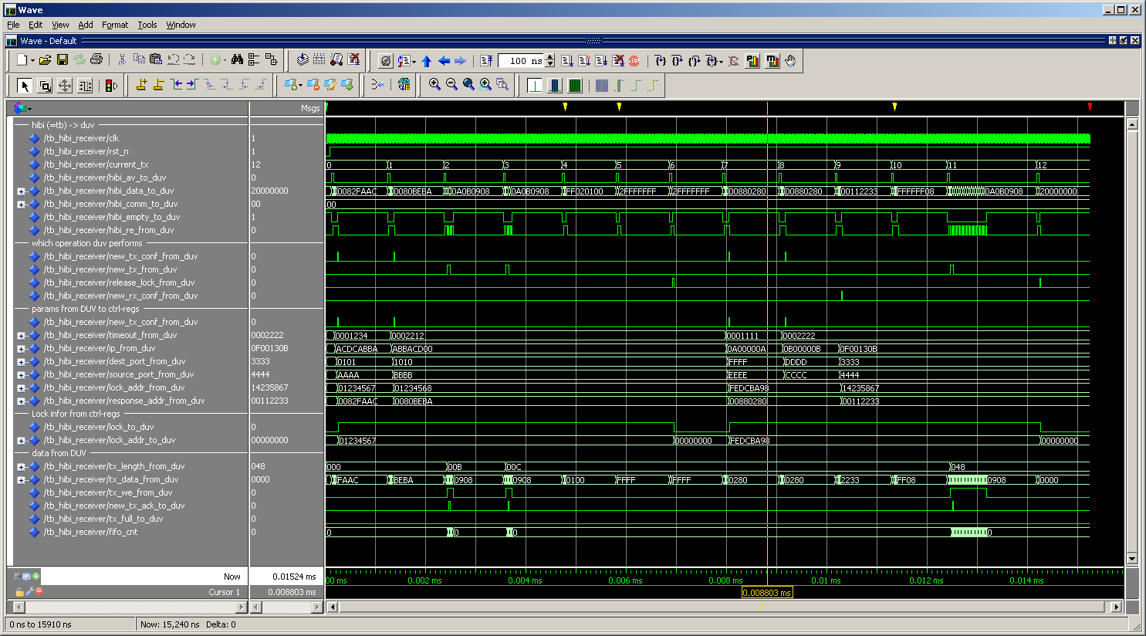
Tb_hibi_receiver.vhd
0) tx conf ok
1) tx conf not ok
2-3) tx ok
4) tx not ok
and so on…
Test ID
Operation type

Slide 32
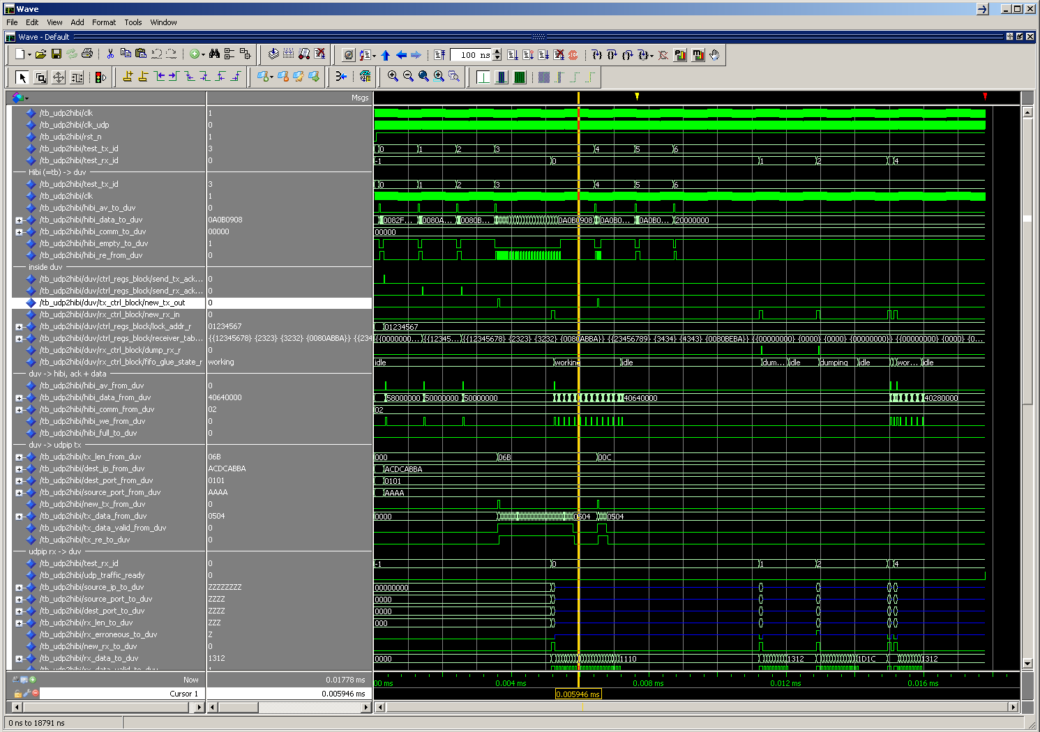
tb_udp2hibi.vhd – visual checking
IDs for tx and rx tests
6) Release ok
0-2) 3 x conf
3) Tx ok
4+5) Tx ok & not ok
0-2) 3 x ack
1) Rx dumped
2) Rx dumped
3+4) Rx ok
0) Rx ok

Slide 33
Controller for DE2 board’s Ethernet chip, including UDP functionality
Jussi Nieminen, Erno Salminen
TUT
October 2009

Slide 34
Contents
Purpose
Block diagram
Basic functionality
Interface
Usage
Current restrictions

Slide 35
Purpose
Made for communication between a DE2 board and a single PC
Not sophisticated enough to be connected to a network
The PC and FPGA applications must know what can and what cannot be sent
More details in the Restrictions slide
Originally designed for a Network-on-Chip monitor application requiring high bandwidth from FPGA to PC
See also Jussi Nieminen, UDP/IP with VHDL, 22.10.2009, file /ip.hwp.interface/udp_ip/1.0/doc /UDP_IP_documentation.pdf

Slide 36
Block diagram
DM9000A
Eth chip
Two blocks
Ethernet chip interface
UDP/IP interface
The blocks in the diagram are not in scale
The current version (UDP/IP and DM9kA controller) takes a little under 2000 logic cells (from the 33,216 of the DE2’s)
FPGA
DM9kA
controller
UDP/IP
UDP/IP headers
ARP
Application

Slide 37
Basic functionality
DM9000A
FPGA
DM9kA
controller
UDP/IP
UDP/IP and DM9kA controller are two separate blocks, so UDP/IP part can also be used with other ethernet controller chips
ARP (address resolution protocol) block handles both ARP requests and replies, so applications (both in PC or in FPGA) don’t have to worry about MAC addresses
After the MAC addresses have been resolved, the UDP/IP block simply inserts or removes headers from outgoing and incoming packets
ARP
UDP/IP headers
Application

Slide 38
Interface
new_tx
tx_length (11b)
destination_address (32b)
destination_port (16b)
source_port (16b)
tx_data (16b)
tx_data_valid
tx_read_enable
UDP/IP
new_rx
Application
(e.g. UDP2HIBI block)
source_address (32b)
source_port (16b)
destination_port (16b)
rx_length (11b)
rx_erroneous
rx_data (16b)
rx_data_valid
rx_read_enable

Slide 39
Usage
When sending a packet, the application must give UDP/IP block following information
Destination IP address
Source port
Destination port
Transfer length
The application must also place valid data to data bus and raise a data_valid signal
When the UDP/IP block is ready, it reads data by raising its read_enable signal
Data bus is 16 bits wide consisting of two separate bytes

Slide 40
Usage (2)
When the UDP/IP block has received a packet, it feeds the application with following information
Source IP address
Source port
Destination port
Transfer length
Indication if transfer is somehow erroneous
The data itself is moved in a similar manner as when transmitting
UDP/IP writes data to the data bus and raises data_valid signal
The application reads the data by raising read_enable signal

Slide 41
Current restrictions
Most of the IP header fields are unusable
In addition to addresses and length fields, only checksum computation is done
No flags, options etc.
No support for packet fragmenting
Length of a transfer < max ethernet frame size (1518 bytes)
Only UDP packets supported, packets of other protocols are simply discarded

